Slide 1
Blockchain and Cryptocurrency Technologies

Slide 2
What is a Blockchain
“A Blockchain is a constantly growing ledger that keeps a permanent record of all the transactions that have taken place, in a secure, chronological and immutable way”

Slide 3
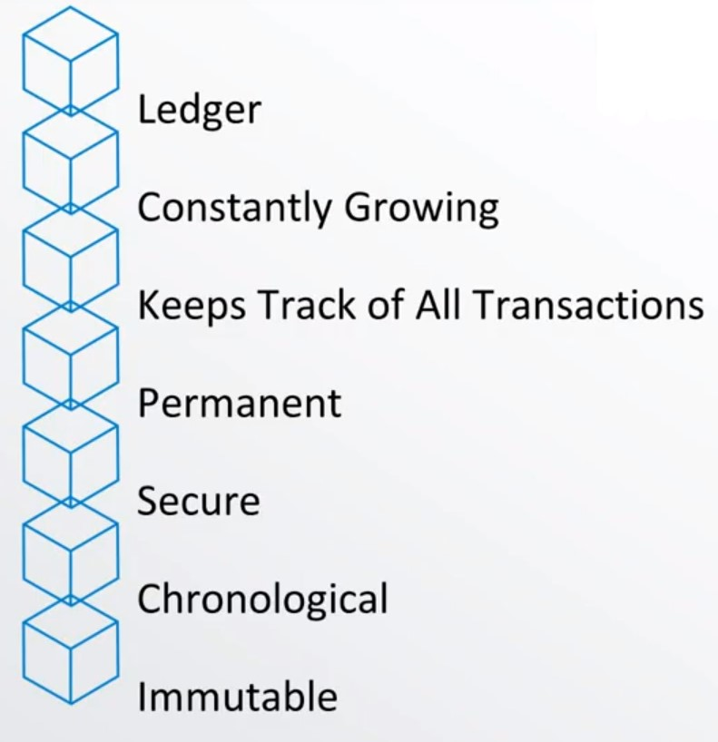
What is a Blockchain

Slide 4
A blockchain is a ledger. It's a file, that's constantly growing.
So it keeps track of all the transactions, in a permanent way. Which means once a transaction goes in, you can't pull it out.
That information is placed in there in a secure way. It uses advanced cryptography to make sure that it's actually locked inside the blockchain.
Every transaction, gets placed in chronologically so every transaction that happens, happens after the previous one.
And finally, it's all immutable which means as you build all these transactions onto the blockchain, this ledger can never be changed.

Slide 5
The basic element of blockchain is a block. The block contains:
Data
Previous Hash (the hash for the previous block)
Hash (the hash value for Data and Previous Hash ).
A digital hash is like a fingerprint

Slide 6

What is a Blockchain
Data: “Welcome to blockchain!”
Previous Hash: 4564FCD789…
Hash: 564CA15478…

Slide 7

What is a Blockchain
Genesis Block
1
2
3
Data: …
Prev. Hash: 0000000000
Hash: 564FD15477
Data: …
Prev. Hash: 564FD15477
Hash: 023291C659
Data: …
Prev. Hash: 023291C659
Hash: 5148ACDF98
“Blocks Are cryptographically linked together”

Slide 8
The first block in the blockchain is called Genesis Block, the prev. Hash for this block is set to zeros because there are no blocks before this block.
As you see in the figure each block is cryptographically linked to the prev. block using the prev. hash.

Slide 9
Blockchain Components
Distributed P2P Network
Mining
Hash Cryptography
1
2
3
Immutable Ledger
Consensus Protocol

Slide 10
We will explore blockchain and talk about five components:
Hash Cryptography
Consensus Protocol
Distributed P2P Network
Immutable Ledger
Mining

Slide 11
What is a Blockchain
Distributed P2P Network
Mining
Hash Cryptography
1
2
3
Immutable Ledger
Consensus Protocol
Notes:
We will start with Hash Cryptography.

Slide 12

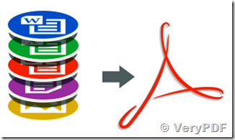
Hash SHA256
0, 1, 2, 3, 4, 5, 6, 7, 7, 8, 9, A, B, C, D, E, F
564CD15477564ABD4E5FDF5FD4C5D456FD4A56FD4C56FD4CACC7DAC8456DF491
SHA256
NSA
Public
64 characters

Slide 13
Each person has its own fingerprint, the odd of finding two people with the same fingerprint is extremely rare. Almost 1 in 60,000,000.
Secure Hash Algorithm 256 (SHA256) is developed by the National Security Agency (NSA) and it is available for the public, it takes input of any length in any format (documents, images, videos, voices, etc…) and convert it to 64 hexadecimal character.

Slide 14
Hash SHA256
Blockchain Demo
https://tools.superdatascience.com/blockchain/hash

Slide 15
Click the previous link, you will be able to type any data in the provided box, the hash will be generated for the data you enter.
For example if you enter “ Welcome to blockchain”, SHA256 will calculate the hash and the result will be:
F488af811d1b6baa9faeec7f4f48a5104d552b1a9d67f7aab73b21418a73d6d8
Note that if you change the text or add even one letter the hash will completely change. Try it!

Slide 16


Hash SHA256
The 5 requirements for Hash algorithms:
One-Way
f290e5b9898484eeecb56f88da8605759073b85fd281211ad46de83b516ad668
One-way means you cannot go backwards. You can not go from the hash to the document, so you cannot restore or reverse engineer the document.

Slide 17
Hash SHA256
The 5 requirements for Hash algorithms:
One-Way
Deterministic
f290e5b9898484eeecb56f88da8605759073b85fd281211ad46de83b516ad668
Deterministic means that if we take exactly the same document and apply the hash algorithm again and again we will get exactly the same hash results.
f290e5b9898484eeecb56f88da8605759073b85fd281211ad46de83b516ad668

Slide 18
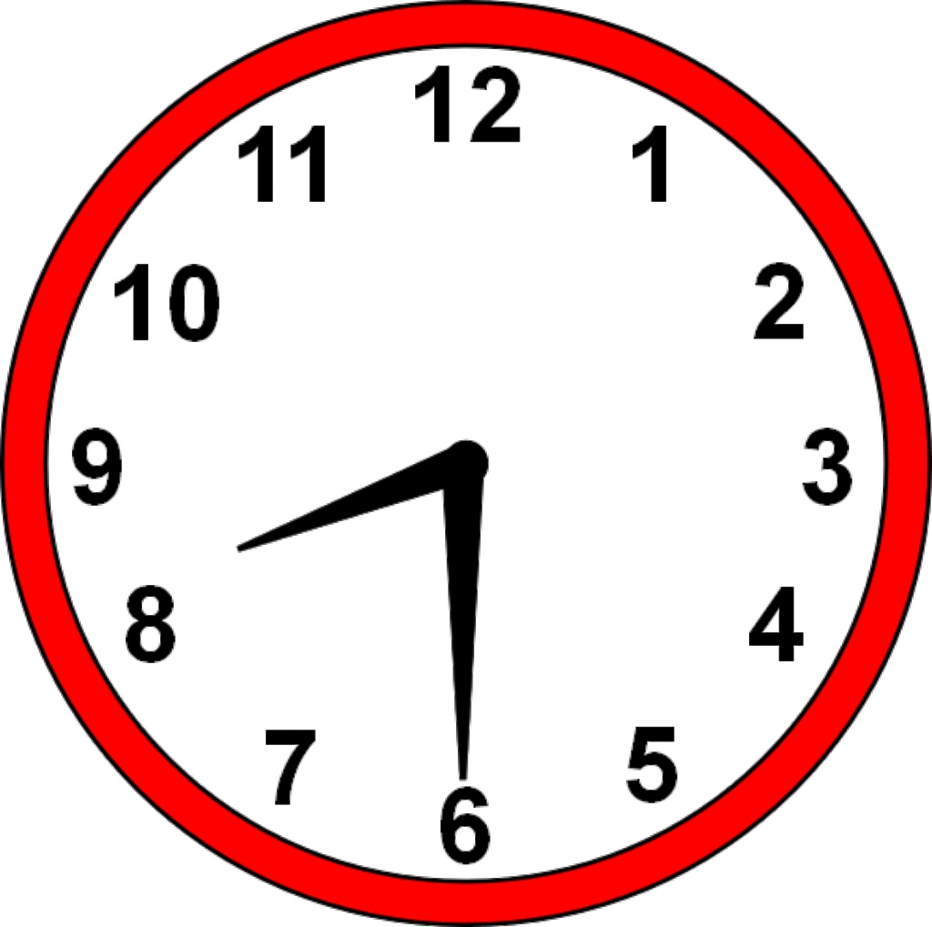
Hash SHA256
The 5 requirements for Hash algorithms:
One-Way
Deterministic
Fast Computation
f290e5b9898484eeecb56f88da8605759073b85fd281211ad46de83b516ad668
Fast computation means it takes fraction of a second to generate the hash value, regardless of the input size, if it is one sentence, or thousands of pages, the SHA256 will always generate the hash value quickly.

Slide 19
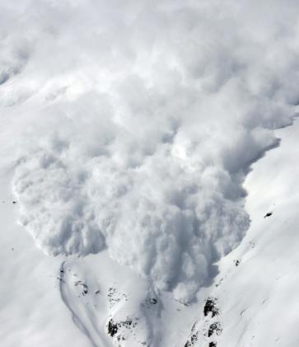
Hash SHA256
The 5 requirements for Hash algorithms:
One-Way
Deterministic
Fast Computation
The avalanche effect
f290e5b9898484eeecb56f88da8605759073b85fd281211ad46de83b516ad668
e8daf8513347d142c13e686e38db42a87a7bf59b6d627e743f9843b615ea442d
+1

Slide 20
The Avalanche Effect
The avalanche effect means that if we take exactly the same document and add or change even one character and calculate the hash again, then the new hash will be totally different than the previous hash. This is called the avalanche effect .

Slide 21


Hash SHA256
The 5 requirements for Hash algorithms:
One-Way
Deterministic
Fast Computation
The avalanche effect
Must withstand collisions
f290e5b9898484eeecb56f88da8605759073b85fd281211ad46de83b516ad668

Slide 22
Must withstand collisions means the intruder will not be able to change the document and generate same hash that was associate with the document before the change. Any change to the document ill lead to new hash value.

Slide 23

Immutable Ledger
Distributed P2P Network
Mining
Hash Cryptography
1
2
3
Consensus Protocol
Immutable Ledger

Slide 24
Now we are done with the first element “Hash Cryptography”, next we will explore the second element of blockchain “ Immutable Ledger”
In the following slides we will understand what we mean by immutable ledger.

Slide 25

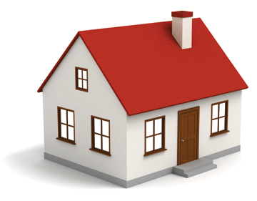

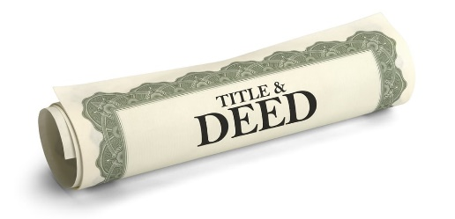




Immutable Ledger
Traditional Ledger
Blockchain

Slide 26
In this example we explain simplified process of buying a house
First you have cash money and you decide to buy a house, in return you will receive a deed that says you own this house, this transaction of buying the house will be registered with the government.
Most of the third world countries are still using traditional ledger to record the ownership of real-estate transactions, so basically they write down in a traditional ledger every transaction.
But using traditional ledger expose threat, if an intruder by any chance get his way and access the traditional ledger, then he simply can erase your name and register the house in his name.

Slide 27
At this time, there is no way to prevent this from happening by using traditional ledger.
Here, blockchain come in picture and if it is used to register real-estate transaction it can prevent such threat.
So, when the record of buying the house is registered in blockchain, at this time it is permanently secured, because if anyone try to change it the link between this block and other block will not be valid anymore.

Slide 28
Immutable Ledger
Traditional Ledger
Blockchain

Slide 29
As you can see in this slide, when an intruder change the data (i.e. the ownership of the house), the block will be invalid, because the hash that was calculated for this block will not match with the new data.

Slide 30
Immutable Ledger
Traditional Ledger
Blockchain

Slide 31
Notice here all of blocks after the hacked one in the chain will be invalid as well, because the previous hash data will not match with the hash of the previous block

Slide 32
Distributed P2P Network
Distributed P2P Network
Mining
Hash Cryptography
1
2
3
Consensus Protocol
Immutable Ledger

Slide 33

Distributed P2P Network

Slide 34
The blockchain will be implemented on distributed P2P network, thousands of nodes participate in the blockchain network, each node keep copy of the blockchain data.

Slide 35
Distributed P2P Network
As you can see in this slide, each node (i.e. computer) keep copy of the blockchain, the blockchain will be identical between all the nodes.

Slide 36
Distributed P2P Network
Once new block is added to the blockchain, each node will copy this new block and add it to its chain.

Slide 37
Distributed P2P Network
The chain keep growing by time and each node maintain its copy to be identical to all other nodes.

Slide 38

Distributed P2P Network

Slide 39
What happen if an intruder try to compromise the data stored in one of the blocks?
As we can see in this slide and the next slide, the compromised block will become invalid, and all next blocks after it will be invalid as well.

Slide 40

Distributed P2P Network
The question now, how the network will prevent such attack?

Slide 41

Distributed P2P Network

Slide 42
All the nodes next to the compromised one, will notice that their blockchain copy is different than the copy of the compromised node.
The adjacent nodes reach to consensus that they all have the same copy except the compromised node, they will force the compromised node to cope their blockchain and go back to valid state.

Slide 43
Distributed P2P Network
All blockchain are valid now.

Slide 44
How Mining Works
Distributed P2P Network
Mining
Hash Cryptography
1
2
3
Consensus Protocol
Immutable Ledger

Slide 45
How Mining Works
Block: #3
This slide shows the components of a block in the blockchain, each block contains block#, data or transactions, the previous block-hash value and its own hash value, none of these information can be changed by the miner, so a new field is added to the block is called nonce.
Data:
John -> Subway 0.001 Bitcoin
Mike -> Microsoft 5 Bitcoin
Sarah -> Joe 70 Bitcoin
Prev.Hash: 0000DF2E57FB432A
Hash: 82B5C4156AE315F7

Slide 46
How Mining Works
Block: #3
Nonce:
Data:
John -> Subway 0.001 Bitcoin
Mike -> Microsoft 5 Bitcoin
Sarah -> Joe 70 Bitcoin
Prev.Hash: 0000DF2E57FB432A
Hash: 82B5C4156AE315F7

Slide 47
The nonce is part of the block information, it is called number only once, or nonce.
The miners use this nonce to play a game, in another word to mine the block, the miner will keep changing the nonce value and calculating the new hash until they find the target hash.

Slide 48
How Mining Works
Block: #3
Nonce: 10955
Data:
John -> Subway 0.001 Bitcoin
Mike -> Microsoft 5 Bitcoin
Sarah -> Joe 70 Bitcoin
Prev.Hash: 3A14DF2E57FB432A
Hash: A63AB36162A4F4EE

Slide 49
As we can see in this slide, with a nonce value = 10955, the calculated hash will be A63AB36162A4F4EE
If this hash value fall in the target hash (the target hash is set by the blockchain protocol) the miner will win and will get the rewards of mining the block, but if the calculated hash is not within the target, then the miner will keep trying to find the target hash by changing the nonce and recalculating the hash.

Slide 50
How Mining Works
- ALL POSSIBLE HASHES -
A Hash is a Number
53cf2adfcc2eccc2eb2fc6ce4a4282ee2b42bf70e54eb4c0519e6c4c2617f05c
00000000000000000000da901c5176b10a6d83961dd3c1ac88b59b2dc327aa4
000000000000000000000000000807d9b054d23c473c106c72be9de08b7376c
LARGEST
SMALLEST

Slide 51
To understand the mining process let us consider the purple box which includes all possible hashes, since the hash number is 64 character then there are limited number of possible hashes, also, the hash value itself is a hexadecimal number, and if we consider the top of the box is the largest number and the bottom of the box is the smallest value then the hash value will fall somewhere in the box based on its value.

